Slide 1
Does Information Matter? The Effects of Directors‘ and Officers’ Insurance on Shareholder Wealth
Derrick W.H. Fung and Jason J. H. Yeh
The Chinese University of Hong Kong
For NTU Economics Seminar

Slide 2
Imperative Virtue or Inevitable Evil?
“In the current environment, companies have a strong incentive to adopt rigorous governance procedures because those that fail to do so will be unable to attract top quality directors and will pay a risk premium in terms of both director compensation and possibly officer and director liability insurance.”
-- Cynthia A. Glassman, SEC Commissioner, in a speech delivered to the National Economists’ Club, April 7, 2003
The full speech by U.S. SEC Commissioner Cynthia A. Glassman can be viewed at http://www.sec.gov/news/speech/spch040703cag.htm .

Slide 3
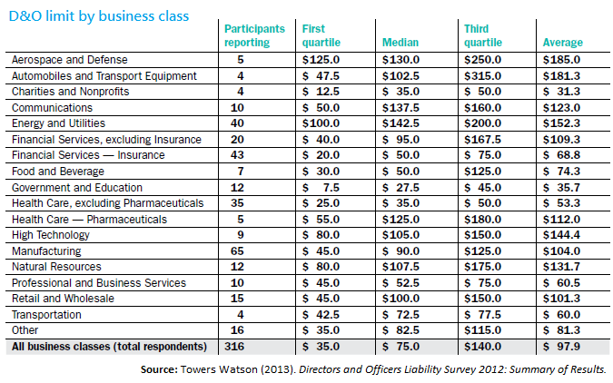
Motivation
D&O insurance is very common in director’s compensation schemes.
According to the 2012 “Directors and Officers Liability Survey” conducted by Towers Watson, the surveyed firms purchase D&O insurance for their directors with a median policy limit of US$75m.
The purchase of D&O insurance is not limited to a few business class only.
Large Mainland corporation buyers
Notes:
http://baike.baidu.com/view/597967.htm#ref_[1]_597967
目前市场上比较大的客户为：
上市公司 保额 保费 承保人
工行 5000万美元 约为148.6万美元 美亚等7家保险公司
中行 5000万美元 不超过70万美元 美亚财险、华泰财险、丘博保险、安联保险、中银保险
招商银行 3000万美元 不详 美亚保险等
民生银行 3000万美元 不超过98.6万美元（内含有6年招股说明书责任险费） 不详
深发展 5000万美元 约为40万美元 不详
中信银行5000万美元 不超过70万美元 美亚保险、华泰财险、安联保险、中银保险、联邦保险
北京银行 15000万元 50万元左右 美亚保险、人保财险
中国平安 3000万美元 420万元人民币 平安财险（找的国际市场上的再保险）
中国人寿 8000万到1亿美元 小于400万美元 不详

Slide 4
Motivation
If D&O insurance is so common, does it enhance firm value from the shareholder’s perspective?
Based on literature, there are generally two streams of views.
Monitoring Effect
D&O insurance helps the firm recruit and retain talented outside directors
(Holderness, 1990; MacMinn et al., 2012)
D&O insurers, who have to cover the liabilities of directors’ bad decisions, help improve the firm’s corporate governance
(Holderness, 1990; O’Sullivan, 1997)
Moral Hazard Effect
D&O insurance undermines the disciplinary effect of shareholder litigation on directors and leads to opportunistic managerial behavior
(Chalmers et al., 2002; Barrese and Scordis, 2006; Lin et al., 2011)
Notes:
Barrese, J., & Scordis, N. (2006). Managerial bias in corporate governance and the effect of D&O insurance: A literature review and synthesis. International Journal of Disclosure and Governance, 3(3), 185-196.
Chalmers, J. M. R., Dann, L. Y., & Harford, J. (2002). Managerial opportunism? Evidence from directors’ and officers’ insurance purchases. Journal of Finance, 57(2), 609-636.
Holderness, C. G. (1990). Liability insurers as corporate monitors. International Review of Law and Economics, 10(2), 115-129.
Lin, C., Officer, M. S., & Zou, H. (2011). Directors’ and officers’ liability insurance and acquisition outcomes. Journal of Financial Economics, 102(3), 507-525.
MacMinn, R., Ren, Y., & Han, L. (2012). Directors, directors and officers insurance, and corporate governance. Journal of Insurance Issues, 35(2), 159-179.
O’Sullivan, N. (1997). Insuring the agents: The role of directors’ and officers’ insurance in corporate governance. Journal of Risk and Insurance, 64(3), 545-556.

Slide 5
Conceptual Framework… Chang et al. (2004)
Firm Value
Moral Hazard Effect
Information Cost
Monitoring Effect
Compensation Linked to Firm Value
Director Reputation
right incentives mitigate moral hazard effect
negative effect
positive effect
higher level of moral hazard effect when information cost is higher, and vice versa
When the information cost is high, outside directors are less effective in monitoring the firm, even given the right incentives (Duchin et al., 2010). Hence, we argue that outside directors rely more on D&O insurance to cover their liabilities for bad decisions, resulting in a higher level of moral hazard effect.
Notes:
Duchin, R., Matsusaka, J. G., & Ozbas, O. (2010). When are outside directors effective? Journal of Financial Economics, 96(2), 195-214.

Slide 6
Hypothesis
Hypothesis 1. Ignoring the information cost to independent directors, the monitoring effect offsets the moral hazard effect, and increasing D&O insurance coverage does not affect firm value on average.
Hypothesis 2. When the information cost to independent directors is low, the monitoring effect dominates the moral hazard effect, and increasing D&O insurance coverage improves firm value.
Hypothesis 3. When the information cost to independent directors is high, the moral hazard effect dominates the monitoring effect, and increasing D&O insurance coverage does not improve firm value.

Slide 7
Data
As Canadian public firms are required to disclose information about D&O insurance in their proxy statements, this research uses a sample of firms on the S&P/TSX Composite Index listed on the Toronto Stock Exchange from 2010 to 2014.
Firms on the S&P/TSX Composite Index from 2010 to 2014
D&O Insurance Data
- whether the firm has purchased D&O insurance
- the coverage limit
- the premium paid
(hand-collected from proxy statements)
Board Characteristics Data
- compensation to directors
- board size
- number of independent directors
- average number of committees on which each independent director serves
(hand-collected from proxy statements)
Firm Value and Characteristics Data
- annual stock return
- market capitalization
- Tobin’s Q
- firm age
- total assets
- book leverage ratio
(downloaded from Compustat)

Slide 8
Measure of information cost to independent directors
As most decision making takes place at the committee level (Kesner, 1988) and independent directors who serve on multiple monitoring committees have a more complete understanding of the firm and can make more informed decisions (Faleye et al., 2011), we argue that the information cost decreases with the number of committees on which each independent director serves.
$$Information Cost to Independent Directors$$
$$=\frac{1}{the average number of committees in which each independent director participates in the sample period}$$
We then divide our whole sample into 3 subgroups according to their corresponding information cost.
Notes:
Faleye, O., Hoitash, R., & Hoitash, U. (2011). The costs of intense board monitoring. Journal of Financial Economics, 101(1), 160-181.
Kesner, I.F. (1988). Directors’ characteristics and committee membership: An investigation of type, occupation, tenure, and gender. Academy of Management Journal, 31(1), 66-84.

Slide 9
Empirical Model
The baseline empirical model is:
V_{jt+1} = αICR_{jt} + …… + f_{j} + s_{t} + e_{jt} (1)
where j represents a firm, t represents a year, V is the firm value, ICR is the insurance coverage ratio, f is the firm-specific effect, s is the year-specific effect, and e is the error term.
To eliminate the firm-specific effect, we run a regression on the first differences as follows:
V_{jt+1} – V_{jt} = α(ICR_{jt} – ICR_{jt-1}) + control variables_{t} + (s_{t} – s_{t-1})+ (e_{jt} – e_{jt-1}) (2)
where (V_{jt+1} – V_{jt}) is represented by the changes in Tobin’s Q, market capitalization, and stock price from year t to year t+1. We include board size, book leverage ratio, firm age, and the logarithm of the market value of equity as control variables. Regression (2) is then run on the whole sample and the 3 subgroups with different information cost separately.

Slide 10
Empirical Results
Regression of change in Tobin’s Q on change in insurance coverage ratio
 | Change in Tobin’s Q (%)
 | All | Low information cost | Medium information cost | High information cost
 | (1) | (2) | (3) | (4)
Δ Insurance coverage ratio (%) | 1.266 (1.47) | 1.800** (2.13) | 5.701*** (5.38) | -0.390 (-0.70)
Board size | 0.928** (2.20) | 2.047*** (4.38) | 1.905** (2.13) | 0.590 (0.89)
Book leverage ratio | -0.918 (-0.20) | -10.586 (-1.59) | -18.329 (-1.48) | 8.365* (1.87)
Firm age | 0.152 (1.68) | 0.317** (2.85) | 0.533*** (3.32) | -0.176 (-1.33)
Log(Market value of equity) | -5.083*** (-4.02) | -7.255** (-2.68) | -8.588*** (-4.38) | -1.659 (-1.39)
Year fixed effects | Yes | Yes | Yes | Yes
48 Fama–French industry fixed effects | Yes | Yes | Yes | Yes
R² | 0.234 | 0.320 | 0.341 | 0.241
Observations | 633 | 217 | 197 | 219

Slide 11
Empirical Results
Regression of change in market capitalization on change in insurance coverage ratio
 | Change in market capitalization (%)
 | All | Low information cost | Medium information cost | High information cost
 | (1) | (2) | (3) | (4)
Δ Insurance coverage ratio (%) | 2.263 (1.04) | 4.120* (1.87) | 6.750*** (3.78) | -0.267 (-0.11)
Board size | -0.166 (-0.17) | 2.134 (1.59) | 1.966 (1.12) | -3.813*** (-2.92)
Book leverage ratio | 6.390 (0.67) | -6.279 (-0.37) | 4.262 (0.20) | 15.630*** (2.80)
Firm age | 0.021 (0.15) | 0.094 (0.73) | 0.650 (1.40) | 0.071 (0.21)
Log(Market value of equity) | -10.311*** (-5.58) | -13.539** (-2.40) | -14.728*** (-3.54) | -6.882** (-2.27)
Year fixed effects | Yes | Yes | Yes | Yes
48 Fama–French industry fixed effects | Yes | Yes | Yes | Yes
R² | 0.245 | 0.383 | 0.299 | 0.258
Observations | 633 | 217 | 197 | 219

Slide 12
Empirical Results
Regression of change in stock price on change in insurance coverage ratio
 | Change in stock price (%)
 | All | Low information cost | Medium information cost | High information cost
 | (1) | (2) | (3) | (4)
Δ Insurance coverage ratio (%) | 2.045 (1.02) | 4.055** (2.17) | 5.914*** (3.96) | -0.686 (-0.39)
Board size | 0.097 (0.14) | 2.063 (1.71) | 1.476 (1.20) | -2.164** (-2.37)
Book leverage ratio | 1.821 (0.22) | -10.527 (-0.83) | -25.572 (-1.40) | 15.082*** (3.30)
Firm age | 0.167 (1.29) | 0.302* (1.92) | 0.796* (2.05) | 0.076 (0.33)
Log(Market value of equity) | -7.036*** (-3.65) | -10.476* (-1.76) | -11.480*** (-3.54) | -2.344 (-1.07)
Year fixed effects | Yes | Yes | Yes | Yes
48 Fama–French industry fixed effects | Yes | Yes | Yes | Yes
R² | 0.327 | 0.459 | 0.383 | 0.364
Observations | 643 | 217 | 207 | 219

Slide 13
Self-selection correction
If a firm endogenously makes its decision to purchase D&O insurance, we have to control the potential self-selection bias by employing the Heckman’s (1979) two-stage regression.
In the selection eq., we model the firm’s decision to purchase D&O insurance.
In the effect eq., the coefficient estimates obtained above are used to construct the inverse Mills ratio, which is the selection bias correction term to control for the possibility that the firm’s decision to purchase D&O insurance is endogeneously determined. The inverse Mills ratio is then added to effect equation as one of the control variables.

Slide 14
Self-selection correction: Empirical Results
Regression of change in Tobin’s Q on change in insurance coverage ratio
Panel A | Change in Tobin’s Q (%)
 | All | Low information cost | Medium information cost | High information cost
 | (1) | (2) | (3) | (4)
Δ Insurance coverage ratio (%) | 0.470 (1.15) | 1.787*** (2.63) | 5.348*** (3.71) | -1.558*** (-3.09)
Board size | 0.838* (1.75) | 0.326 (0.30) | 1.339* (1.71) | 0.227 (0.34)
Book leverage ratio | 1.473 (0.41) | 0.063 (0.01) | 15.877** (2.05) | -3.771 (-0.67)
Firm age | 0.228*** (2.66) | 0.463*** (2.82) | 0.263* (1.68) | 0.049 (0.44)
Log(Market value of equity) | -5.399*** (-5.95) | -6.850*** (-3.50) | -5.690*** (-3.38) | -1.605 (-1.36)
ρ | 0.150 (0.66) | 0.281 (0.75) | -0.499* (-1.70) | 0.460 (1.38)
Year fixed effects | Yes | Yes | Yes | Yes
Observations | 340 | 101 | 111 | 128

Slide 15
Self-selection correction: Empirical Results
Regression of change in market capitalization on change in insurance coverage ratio
Panel B | Change in market capitalization (%)
 | All | Low information cost | Medium information cost | High information cost
 | (1) | (2) | (3) | (4)
Δ Insurance coverage ratio (%) | 0.699 (0.82) | 4.873*** (3.45) | 6.178*** (2.95) | -3.507*** (-2.86)
Board size | 1.998** (2.24) | -2.525 (-0.88) | 1.713 (1.54) | 1.023 (0.76)
Book leverage ratio | 19.437*** (2.63) | 36.428** (2.34) | 44.051*** (3.76) | 10.878 (0.91)
Firm age | 0.280* (1.78) | 1.058*** (2.89) | 0.149 (0.68) | -0.035 (-0.16)
Log(Market value of equity) | -7.681*** (-4.45) | -9.662** (-2.31) | -8.954*** (-3.66) | -1.257 (-0.54)
ρ | 0.839*** (18.85) | 0.965*** (30.21) | -0.761*** (-3.77) | 0.955*** (28.85)
Year fixed effects | Yes | Yes | Yes | Yes
Observations | 340 | 101 | 111 | 128

Slide 16
Self-selection correction: Empirical Results
Regression of change in stock price on change in insurance coverage ratio
Panel C | Change in stock price (%)
 | All | Low information cost | Medium information cost | High information cost
 | (1) | (2) | (3) | (4)
Δ Insurance coverage ratio (%) | 0.625 (0.77) | 4.631*** (3.39) | 5.390*** (2.96) | -3.198*** (-2.73)
Board size | 1.891** (2.22) | -1.886 (-0.78) | 1.284 (1.20) | 0.770 (0.58)
Book leverage ratio | 17.770** (2.55) | 33.879** (2.30) | 40.422*** (3.85) | -1.096 (-0.09)
Firm age | 0.409*** (2.71) | 1.103*** (3.48) | 0.293 (1.42) | 0.141 (0.65)
Log(Market value of equity) | -7.093*** (-4.30) | -9.441** (-2.45) | -7.073*** (-3.07) | -2.080 (-0.90)
ρ | 0.820*** (16.44) | 0.953*** (27.72) | -0.808*** (-5.29) | 0.873*** (9.69)
Year fixed effects | Yes | Yes | Yes | Yes
Observations | 343 | 101 | 114 | 128

Slide 17
Scatter Plots by Groups (All firms)

Slide 18
Scatter Plots: Low Info. Cost Group

Slide 19
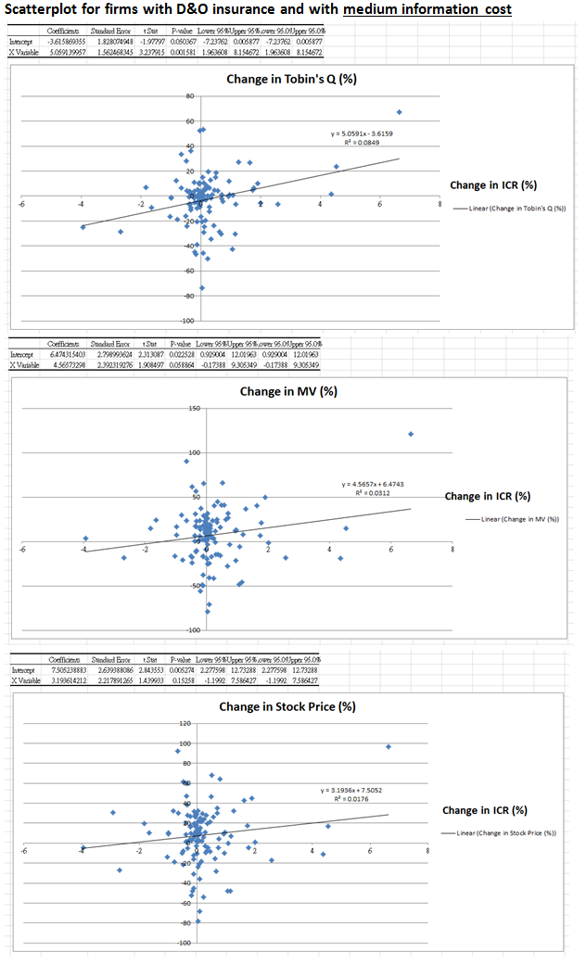
Scatter Plots: Medium Info. Cost Group

Slide 20
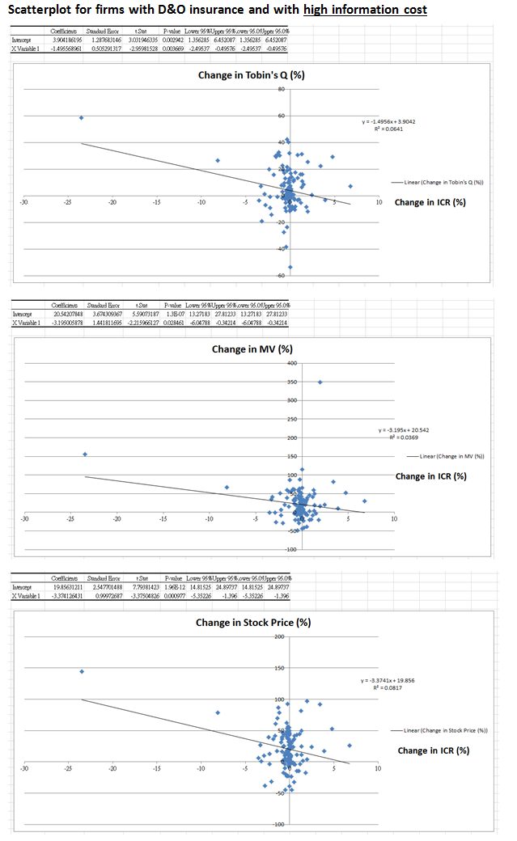
Scatter Plots: High Info. Cost Group

Slide 21
Empirical Results
The empirical results suggest that the effectiveness of D&O insurance depends on the information cost, which support our hypothesis 1, 2 and 3.
If a firm has an insurance coverage ratio equal to the sample mean (1.68%) and increases its insurance coverage ratio by half (0.84%), then the Tobin’s Q, market capitalization, and stock price in the subsequent year will respectively increase by 1.51%, 3.46% and 3.41% for the group with a low information cost and 4.79%, 5.67% and 4.97% for the group with a medium information cost.
Next, we explore the following robustness tests:
Is change in D&O insurance coverage endogenously determined?
Are empirical results dependent on the choice of proxy for information cost?
Are there alternative interpretation of empirical results?
Does decreasing the information cost improve firm value?

Slide 22
Is change in D&O insurance coverage endogenously determined?
If change in the D&O insurance coverage ratio is endogenously determined, then we should use the instrumental variable approach to deal with the endogeneity issue.
A body of research argues that D&O insurance coverage is determined by a number of factors, such as the director compensation package (Chang et al., 2015), directors’ risk-aversion (Parry and Parry, 1991), financial distress (Core, 1997), litigation risk (Chalmers et al., 2002), and firm complexity (Boyer, 2014)
We run regressions to determine whether these factors do affect the dynamic change in D&O insurance coverage ratio.
Notes:
Boyer, M. M. (2014). Directors’ and officers’ insurance and shareholders’ protection. Journal of Financial Perspectives, 2(1), 107-128.
Chalmers, J. M. R., Dann, L. Y., & Harford, J. (2002). Managerial opportunism? Evidence from directors’ and officers’ insurance purchases. Journal of Finance, 57(2), 609-636.
Chang, S. C., Ren, Y., & Yeh, J. J. H. (2015). The role of information: When is directors’ and officers’ insurance value-added? Working Paper.
Core, J. E. (1997). On the corporate demand for directors’ and officers’ insurance. Journal of Risk and Insurance, 64(1), 63-87.
Parry, M. E., & Parry, A. E. (1991). The purchase of insurance by a risk-neutral firm for a risk-averse agent. Journal of Risk and Insurance, 58(1), 30-46.

Slide 23
Is change in D&O insurance coverage endogenously determined?
Regression of change in insurance coverage ratio on changes in director compensation, risk-aversion of directors, financial distress, complexity and litigation risk
Regression of change in insurance coverage ratio on the static position of director compensation, risk-aversion of directors, financial distress, complexity and litigation risk
 | Δ Insurance coverage ratio (%)
 | (1) | (2) | (3)
Δ Director compensation in cash (C$m) | -1.031 (-0.52) | -1.022 (-0.51)
Δ Director compensation in stocks (C$m) | -0.827 (-0.30)
Δ Director compensation in options (C$m) | -0.432 (-0.70)
Δ Director compensation in stocks and options (C$m) |  | -0.514 (-1.60)
Δ Total director compensation (C$m) |  |  | -0.593 (-1.28)
Δ Number of independent directors | -0.076 (-0.95) | -0.076 (-0.94) | -0.075 (-0.93)
Δ Book leverage ratio | -0.421 (-0.84) | -0.421 (-0.84) | -0.412 (-0.85)
Δ Complexity | -0.082 (-1.40) | -0.082 (-1.42) | -0.082 (-1.47)
Acquirer | -0.173 (-1.06) | -0.178 (-1.24) | -0.180 (-1.24)
Divestor | 1.649 (1.39) | 1.656 (1.40) | 1.656 (1.40)
Annual stock return (t-1) (%) | 0.001 (0.36) | 0.001 (0.36) | 0.001 (0.35)
Year fixed effects | Yes | Yes | Yes
48 Fama–French industry fixed effects | Yes | Yes | Yes
R² | 0.178 | 0.178 | 0.178
Observations | 621 | 621 | 621
 | Δ Insurance coverage ratio (%)
 | (1) | (2) | (3)
Director compensation in cash (C$m) | 0.159 (0.17) | 0.170 (0.18)
Director compensation in stocks (C$m) | 0.327 (0.24)
Director compensation in options (C$m) | -0.061 (-0.07)
Director compensation in stocks and options (C$m) |  | 0.073 (0.07)
Total director compensation (C$m) |  |  | 0.111 (0.14)
Number of independent directors | 0.010 (0.31) | 0.014 (0.38) | 0.014 (0.36)
Book leverage ratio | -0.005 (-0.01) | 0.002 (0.01) | 0.002 (0.01)
Complexity | -0.105* (-1.77) | -0.106* (-1.79) | -0.106* (-1.78)
Acquirer | -0.193 (-1.15) | -0.197 (-1.18) | -0.198 (-1.22)
Divestor | 1.628 (1.39) | 1.631 (1.39) | 1.632 (1.38)
Annual stock return (t-1) (%) | 0.002 (0.77) | 0.002 (0.76) | 0.002 (0.76)
Year fixed effects | Yes | Yes | Yes
48 Fama–French industry fixed effects | Yes | Yes | Yes
R² | 0.176 | 0.176 | 0.176
Observations | 621 | 621 | 621

Slide 24
Is change in D&O insurance coverage endogenously determined?
As complexity is marginally correlated with change in D&O insurance coverage ratio, we use complexity as an instrumental variable and compare the instrumental variable estimates to ordinary least squares estimates by the Hausman specification test, which returns χ² statistics less than 3.99 and p-values more than 0.55.
Therefore, we conclude that the endogeneity issue for change in D&O insurance coverage is not material, and application of the instrumental variable approach is not necessary.
(Note: Typically, growth firms have more complex investment opportunities and a higher ratio of market value of equity to book value of equity. Hence, we define complexity as the ratio of market value of equity to book value of equity.)

Slide 25
Are empirical results dependent on the choice of proxy for information cost?
One may still be skeptical of whether our empirical results are robust to other measures of information cost.
Coffee (1999) and Stulz (1999) argue that firms cross-listed in the US are subject to higher standard of disclosure requirements and hence are more transparent. Baker et al. (2002) and Lang et al. (2003) also find that firms cross-listed in the US have more analyst coverage and media attention, resulting in better information environments.
Following the above findings, we assume that firms in our sample which are cross-listed in the US have lower information cost and we construct a cross-listing dummy variable to proxy for the low information cost environment.
Notes:
Baker, H. K., Nofsinger, J. R., & Weaver, D. G. (2002). International cross-listing and visibility. Journal of Financial and Quantitative Analysis, 37(3), 495-521.
Coffee, J. C. (1989). The future as history: The prospects for global convergence in corporate governance and its implications. Northwestern University Law Review, 93(3), 641-707.
Lang, M. H., Lins, K. V., & Miller, D. P. (2003). ADRs, analysts, and accuracy: Does cross listing in the United States improve a firm’s information environment and increase market value? Journal of Accounting Research, 41(2), 317-345.
Stulz, R. M. (1999). Globalization, corporate finance and the cost of capital. Journal of Applied Corporate Finance, 12(3), 8-25.

Slide 26
Are empirical results dependent on the choice of proxy for information cost?
The regression results suggest that increasing insurance coverage ratio enhances firm value for the firms with low information cost (as proxied by their dual listing in the US).
Regression of change in firm value on change in insurance coverage ratio
 | Change in firm value
 | Change in Tobin’s Q (%) |  | Change in market capitalization (%) |  | Change in stock price (%)
 | (1) | (2) | (3) | (4) | (5) | (6)
Δ Insurance coverage ratio (%) | 1.266 (1.47) |  | 2.263 (1.04) |  | 2.045 (1.02)
Δ Insurance coverage ratio (%) x Cross-listing dummy variable |  | 4.057* (1.98) |  | 6.458** (2.65) |  | 5.843** (2.42)
Board size | 0.928** (2.20) | 0.916** (2.24) | -0.166 (-0.17) | -0.174 (-0.18) | 0.097 (0.14) | 0.090 (0.12)
Book leverage ratio | -0.918 (-0.20) | -2.223 (-0.45) | 6.390 (0.67) | 4.317 (0.41) | 1.821 (0.22) | -0.016 (-0.00)
Firm age | 0.152 (1.68) | 0.159* (1.77) | 0.021 (0.15) | 0.031 (0.22) | 0.167 (1.29) | 0.176 (1.40)
Log(Market value of equity) | -5.083*** (-4.02) | -5.022*** (-3.90) | -10.311*** (-5.58) | -10.221*** (-5.56) | -7.036*** (-3.65) | -6.955*** (-3.58)
Year fixed effects | Yes | Yes | Yes | Yes | Yes | Yes
48 Fama–French industry fixed effects | Yes | Yes | Yes | Yes | Yes | Yes
R² | 0.234 | 0.234 | 0.245 | 0.243 | 0.327 | 0.325
Observations | 633 | 633 | 633 | 633 | 643 | 643

Slide 27
Are there alternative interpretation of empirical results?
If firms with a low information cost have lower D&O insurance coverage when compared to firms with a high information cost, one may argue that the effectiveness of changing D&O insurance coverage depends on a firm’s initial level of insurance coverage, instead of its information cost.
However, we find that the group of firms with a low information cost has a D&O insurance coverage ratio of 1.97%, which is not statistically different from the D&O insurance coverage ratio of 1.75% for the group of firms with a high information cost. Testing the difference in average D&O insurance coverage ratio between these two groups yields a p-value of 0.446.
Therefore, we rule out the explanation that the positive relation between D&O insurance coverage and firm value for firms with a low information cost is due to their initial level of insurance coverage.

Slide 28
Does decreasing the information cost improve firm value?
We construct a subsample of firms whose change in D&O insurance coverage limit is zero (including those firms that do not have any D&O insurance) and run the following regression:
V_{jt+1} – V_{jt} = α(information cost_{jt} – information cost_{jt-1}) + control variables_{t} + (s_{t} – s_{t-1})+ (e_{jt} – e_{jt-1})
where (V_{jt+1} – V_{jt}) is represented by the changes in Tobin’s Q, market capitalization, and stock price from year t to year t+1. We include board size, book leverage ratio, firm age, and the logarithm of the market value of equity as control variables.
$Information Cost$_{t}
$$=\frac{1}{the average number of committees in which each independent director participates in year t}$$

Slide 29
Does decreasing the information cost improve firm value?
Based on these ambiguous regression results, we can hardly conclude any association between the information cost and firm value if we keep the insurance coverage limit constant.
Regression of change in firm value on change in information cost for firms without change in D&O coverage limit
 | Change in firm value
 | Change in Tobin’s Q (%) |  |  | Change in market capitalization (%) |  |  | Change in stock price (%)
 | Firms with no change in D&O coverage limit
 | All | Firms without D&O insurance | Firms with D&O insurance | All | Firms without D&O insurance | Firms with D&O insurance | All | Firms without D&O insurance | Firms with D&O insurance
 | (1) | (2) | (3) | (4) | (5) | (6) | (7) | (8) | (9)
Δ Information cost | -18.681** (-2.11) | -17.253 (-1.17) | -12.477 (-1.35) | -1.208 (-0.15) | -1.985 (-0.23) | 9.374 (0.65) | -6.332 (-0.65) | -12.475 (-1.03) | 8.854 (0.68)
Board size | 0.893** (2.28) | 1.299** (2.77) | 0.536 (0.89) | -0.292 (-0.30) | 0.023 (0.02) | 0.123 (0.08) | -0.144 (-0.19) | 0.433 (0.60) | -0.022 (-0.01)
Book leverage ratio | 0.542 (0.12) | 1.235 (0.15) | -1.925 (-0.26) | 13.668* (1.71) | 10.653 (0.76) | 31.753 (1.60) | 5.424 (0.67) | 4.598 (0.33) | 16.981 (0.96)
Firm age | 0.166 (1.50) | 0.263** (2.52) | 0.055 (0.32) | 0.057 (0.37) | 0.191 (1.24) | -0.295 (-0.79) | 0.201 (1.27) | 0.367** (2.66) | -0.148 (-0.42)
Log(Market value of equity) | -5.945*** (-3.44) | -6.856** (-2.79) | -5.391* (-1.77) | -11.198*** (-3.36) | -13.022*** (-4.81) | -9.013* (-1.72) | -8.432*** (-2.77) | -9.402*** (-3.57) | -7.241 (-1.34)
Year fixed effects | Yes | Yes | Yes | Yes | Yes | Yes | Yes | Yes | Yes
48 Fama–French industry fixed effects | Yes | Yes | Yes | Yes | Yes | Yes | Yes | Yes | Yes
R² | 0.262 | 0.246 | 0.365 | 0.273 | 0.278 | 0.371 | 0.353 | 0.358 | 0.420
Observations | 551 | 286 | 265 | 551 | 286 | 265 | 560 | 293 | 267

Slide 30
Conclusion
When the information cost to independent directors is low, the monitoring effect dominates the moral hazard effect and D&O insurance improves firm value, which is reflected in changes of Tobin’s Q, market capitalization and stock price in the subsequent year.
When the information cost to independent directors is high, the moral hazard effect dominates the monitoring effect, and there is no statistically significant relationship between D&O insurance and firm value.
The optimal level of D&O insurance varies across firms according to the information cost structure. Our results show that the abolition of D&O insurance does not add value to all firms, contrary to the viewpoint of some scholars.

Slide 31
Thank You for Your Attention
Q&A

