Slide 1
Global Value Chains and China’s Exports to High Income Countries
Yuqing Xing
National Graduate Institute for Policy Studies
Tokyo, Japan

Slide 2
Why are Chinese Exports so Competitive?
The answers from the literature:
Abundant labor endowment and corresponding comparative advantage in labor-intensive products (Adams, Gangnes and Shachmurove, 2006; Wang 2006);
The reforms of domestic institutions, such as the transition to an market oriented economy, the adoption of export-led growth strategy and unilateral trade liberalization (Hu and Khan, 1997; Lin, Cai and Li, 2003);
Improved market access for China’s exports through institutional arrangements, namely the WTO membership, bilateral and multilateral free trade agreements and the abolishment of multi-fiber arrangement (Branstetter and Lardy, 2006; Prasad, 2009);
The exchange rate regimes adopted by the Chinese government and the undervalued currency (Naughton, 1996; Marquez and Schindler, 2007; Thorbecke and Smith, 2010); and
Massive inflows of export oriented foreign direct investment (Zhang and Song, 2000; Whalley and Xin, 2010).

Slide 3
Questions Cannot be Answered by Comparative Advantage
Without foreign brands, could “Made in China” products maintain the same competitiveness?
Whenever Apple launches new cutting-edge products, the shipment of Apple products from China to increases. Whom should be given credits to for the increase, the innovative American company Apple, or China’s Cheap labor?
Wal-Mart purchases about $18 billion “Made in China for Wal-Mart” products. What is the role of the retail networks of Wal-Mart in facilitating China’s exports to the US?

Slide 4
GVCs in Actions
Today’s trade, nonetheless, is not “wine for clothes”. The proliferation of global value chains has transformed trade in goods into trade in tasks (Grossman and Rossi-Hansberg, 2008).
Many firms located in various geographic locations jointly delivery ready-to-use products to consumers of the global market.
The comparative advantage of individual countries cannot decide the competitiveness of products manufactured along GVCs.
Brands, global distribution networks and technology innovations perform far more important roles in determining winners and losers.
GVCs are particular relevant to China’s exports, as about half of its manufacturing exports are assembled with imported parts and components, and most of so called “Made in China” products either carry brands owned by multinational enterprises (MNE) or are distributed by global retail giants such as Wal-Mart.

Slide 5
Our Hypotheses
GVCs developed by MNEs have been functioning as a vehicle for Chinese exports entering international markets, especially the market of high income countries.
By successfully plugging into GVCs, Chinese firms are able to bundle low skilled labor services with globally recognized brands and advanced technologies of MNEs, and sell them to consumers in international markets.
GVCs are actually a catalyst for “Made in China” products, strictly speaking, China’s value added embedded in its manufacturing exports, being bought and consumed in various nations.
Technology innovations, brands and distribution networks of GVCs’ lead firms constantly expand and create new demand, which in turn lifting the demand for tasks performed by Chinese firms integrated with supply chains, and eventually enhancing China’s exports.

Slide 6
What Are Global Value Chains?
A global value chain comprises a series of tasks necessary for delivering a product from its inception to final consumers of international markets, including research and development, product design, manufacturing parts and components, assembly and distribution, which are carried out by firms located in various countries (Gereffi and Karina, 2011).
Producer-driven chains are generally developed by technology leaders in automobiles, aircraft, computers, semiconductors and other capital-intensive industries;
Buyer-driven chains are typically developed by large retailers, branded marketers and branded manufacturers (Gereffi, 1999)
Notes:
Sources:
1. 2010 Statistical Bulletin of China’s Outward Foreign Direct Investment, Ministry of Commerce, PRC.
2. Yin-Wong Cheung, Jakob De Haan, Xingwang Qian, Shu Yu; “China’s Outward Direct Investment in Africa” October 2010.

Slide 7
Spillover Effects of GVCs I: Brands
Consumers of developed countries tend to be brand oriented and have high willingness to pay for particular brands. Brands are one of critical factors determining consumers’ choices (Bronnenberg, Dube and Gentzkow, 2012).
Compared with non-branded products with equal or even lower costs, the labels of international brands strengthen the competitiveness of “Made in China” products and enhance their appeal to consumers.
The preferences of brand-oriented consumers are implicitly transformed into the demand for “Made in China” products.
Branded clothing constitute the majority of European clothing market with around 80% market share, only 20% left to private labels and non-branded clothing (Copenhagen Economics, 2013).
Notes:
Going Out: An Overview of China’s Outward Foreign Direct Investment ;
USCC Staff Research Report, March 30, 2011
Oil data: National Bureau of Statistics of China, China Statistical Yearbook 2010.

Slide 8
Spillover Effects of GVCs II: Technology Innovations
To a large extent, new and fast growing markets have been nurtured by technology innovations and product inventions.
In 2012, ICT goods emerged as one of top products traded globally. The world imports of ICT goods rose to US$2 trillion, about 11% of world merchandise trade and exceeded trade in agriculture and motor vehicle (UNCTAD, 2014).
If not all, most of intellectual properties of ICT products are owned by MNEs of developed countries
By participating in the value chains of high-tech products and specializing on low value added segments, Chinese firms can join the value creation process of high-tech products.
China’s leading positions in exports of laptop computers, digital cameras, mobiles and other similar ICT products have been achieved via specializing on low value added task-assembly of those products rather than indigenous technology innovations.

Slide 9
Spillover Effects of GVCs III: Distribution Networks
Distribution: The existence of basic marketing and distribution infrastructure is prerequisite for supply and demand to be interconnected with one another (Wgan and Mody, 1992).
The required buyer-seller relations for exporting commodities to foreign markets are naturally built in GVCs. For firms without their own global distribution networks, joining GVCs can mitigate information deficiency, reduce transaction costs and facilitate the market access.
Wal-Mart, if counted as a “nation”, is the 7th largest trading partner of China and importing more than $18 billion goods from China annually (Lee, Gereffi and Barrientos, 2011).
The retail networks of Wal-Mart provide essential marketing and distributions infrastructure for “Made in China” products.

Slide 10
GVCs and China’s Exports I: the iPhone Trade
China has been the exclusive exporter of the iPhone. In 2009, it exported 11.3 million iPhones valued at $2.0 billion to the US.
In 2011, China’s iPhone export to the US surged to $8.5 billion, despite of rising wage and the appreciation of the Yuan.
That China exports the iPhone to the US, where the iPhone was invented, appears inconsistent with the classic theory of comparative advantage. The strange trade pattern, however, can easily be explained by GVCs.
“Designed by Apple in California Assembled in China”

Slide 11
GVCs and China’s Exports II: High-tech Exports
In 2012, China exported US$600 billion high-tech goods, about 1/3 of China’s manufacturing exports.
Foreign invested firms produce more than 80%;
About 80% of China’s high-tech exports are processing exports;
Foreign value added remains above 50%,
processing high-tech exports are results of GVC operations.
The technology sophistication of China’s high-tech exports is primarily determined by technology innovations of lead firms.
The Domestic Value Added of China’s Processing High-tech Exports
Source: Xing (2014)

Slide 12
GVCs and China’s Exports III: Processing Exports
In 2012, processing exports amounted US$860 billion, about 42% of China’s total exports.
During 1997-2007, it generally exceeded 50% of China’s total exports.
East Asian economies are the major origins of processing imports while G-7 countries main destination markets.
The triangle trade pattern formed by processing trade outlines an aggregated GVC with China in the middle.
Processing Exports and Domestic Value Added (%)
Source: Xing (2014)

Slide 13
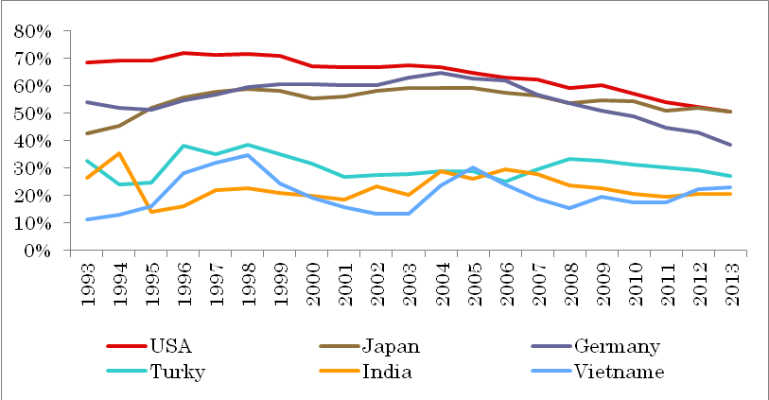
The Intensities of Processing Exports in China’s Bilateral Exports
It is straightforward to see a divergence between high and low income countries.
Processing exports comprised about 65% of China’s exports to the US, 55% to Japan and Germany.
In contrast, processing exports on average accounted for 30% of China’s exports to Turkey, 23% to India and 21% to Vietnam.
Source: Authors calculation

Slide 14
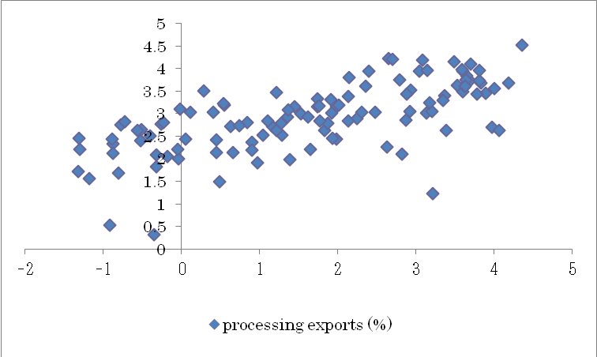
Processing Exports and the Income of China’s trading partners
The horizontal axis denotes the share of processing exports and the vertical axis GDP per capita. The logarithm of both variables is used. The sample includes 115 China’s trading partners in 2012.
Source: Authors calculation

Slide 15
Processing Exports and the Income of Importing Countries: Econometric Analysis
P_{jt} the share of processing exports in China’s exports to country j;
Y_{jt} denotes GDP per capita of country j;
∆S_{jt} depreciation of Chinese Yuan against the currency of country j.
Control Variables:
Dummies: Entrepot, Asian countries and the post WTO entry (after 2001).
The time trend T and its interactions with GDP per capita.
DATA:
2,276 observations, about 100 observations annually, ranging from 98 to 118 observations per year, and spanning from 1994-2013;
Sources: China Customs General; the IFS, and WB Development Indicators;

Slide 16
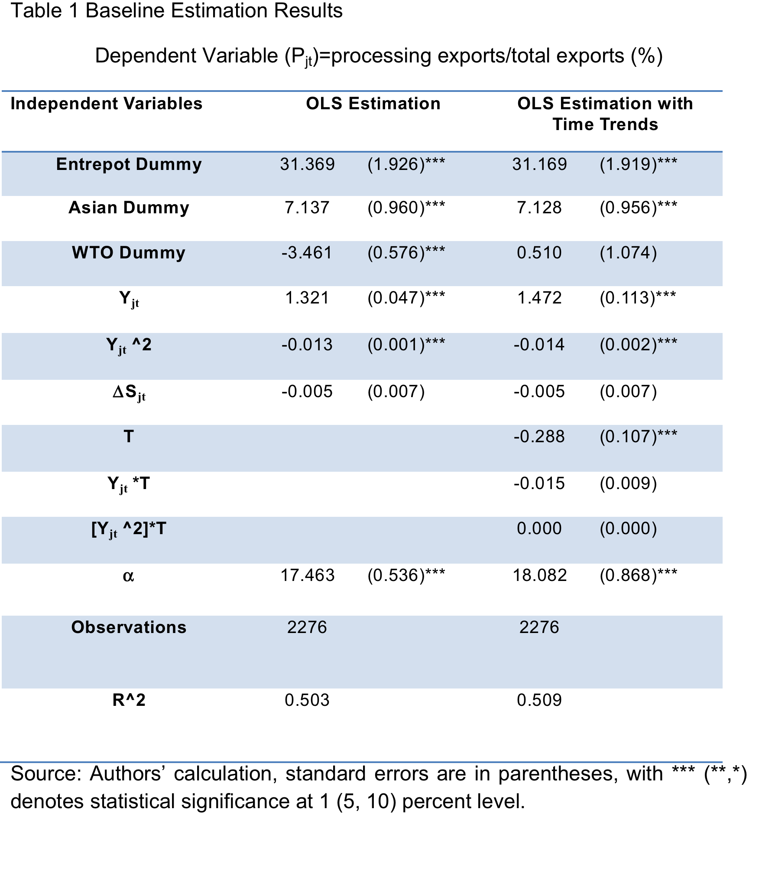

Slide 17
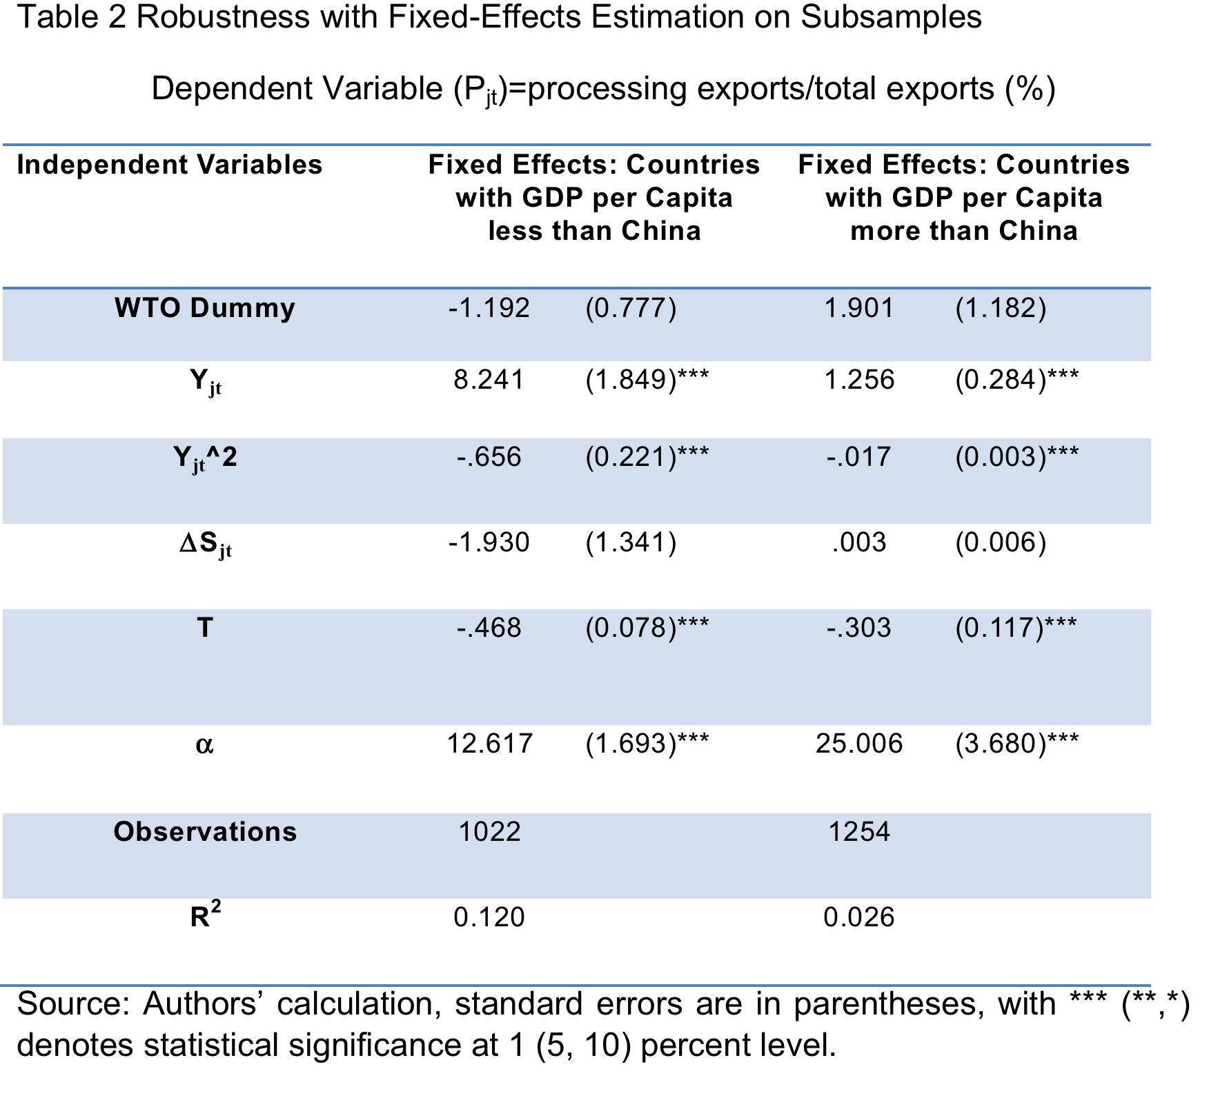

Slide 18
The Economic Significance of Control Variables in China’s Bilateral Processing Exports
Source: Authors’ calculation
The economic significance of GDP per capita is a product of its coefficient estimate, 1.472, and its standard deviation, 1.606 (thousands US$), which implies that a one standard deviation increase in GDP per capita in import countries increases the proportion of processing exports by 2.364 percent in total exports from China.

Slide 19
Concluding Remarks
China’s exports have benefited substantially from the spillover effects of brands, technology innovations and distribution networks of GVCs;
By taking part in GVCs, Chinese firms can bundle low skilled labor services with globally recognized brands and advanced technology, then sell to global consumers;
More than 50% foreign value added imbedded in processing exports suggest that, the competitiveness of the exports is mainly determined by foreign contents;
Processing trade actually functions as a vehicle for “Made in China” to enter the markets of high income countries;
The empirical analysis, based on the bilateral processing trade data covering most of China’s trading partners from 1993-2013, shows that there exists a significant positive correlation between the share of processing exports and the income of import countries;
The cross-country heterogeneity of processing exports also indicate that, China actually captures relatively more value added from its exports to low income countries than that to high income countries.

Slide 20
Thank you!
For questions, please contact Prof. Yuqing Xing at yuqing_xing@grips.ac.jp

